Slide 1

Global Marketing
Tenth Edition
Chapter 8
Importing, Exporting, and Sourcing
Copyright © 2020, 2017, 2015 Pearson Education, Inc. All Rights Reserved
Notes:
If this PowerPoint presentation contains mathematical equations, you may need to check that your computer has the following installed:
1) MathType Plugin
2) Math Player (free versions available)
3) NVDA Reader (free versions available)

Slide 2
Learning Objectives (1 of 2)
8.1 Compare and contrast export selling and export marketing.
8.2 Identify the stages a company goes through, and the problems it encounters, as it gains experience as an exporter.
8.3 Describe the various national policies that pertain to imports and exports.
8.4 Explain the structure of the Harmonized Tariff System.
8.5 Describe the various organizations that participate in the export process.

Slide 3
Learning Objectives (2 of 2)
8.6 Identify home-country export organization considerations.
8.7 Identify market-country export organization considerations.
8.8 Discuss the various payment methods that are typically used in trade financing.
8.9 Identify the factors that global marketers consider when making sourcing decisions.

Slide 4
Export Selling versus Export Marketing
Export selling involves selling the same product, at the same price, with the same promotional tools in a different place.
Export marketing tailors the marketing mix to international customers.
Notes:
As organizations seek to move operations into other countries, they need to make the basic decision regarding their level of involvement in the foreign markets. Two broad areas include export selling and export marketing.
Export selling does not involve tailoring the product, the price, or the promotional material to suit the requirements of global markets. The only marketing mix element that differs is the “place;” that is, the country where the product is sold. This selling approach may work for some products or services; for unique products with little or no international competition, such an approach is possible. Similarly, companies new to exporting may initially experience success with selling.
Export marketing targets the customer in the context of the total market environment. The export marketer does not simply take the domestic product “as is” and sell it to international customers. To the export marketer, the product offered in the home market represents a starting point. It is modified as needed to meet the preferences of international target markets; this is the approach the Chinese have adopted in the U.S. furniture market. Similarly, the export marketer sets prices to fit the marketing strategy and does not merely extend home country pricing to the target market. Charges incurred in export preparation, transportation, and financing must be taken into account in determining prices. Finally, the export marketer also adjusts strategies and plans for communications and distribution to fit the market. In other words, effective communication about product features or uses to buyers in export markets may require creating brochures with different copy, photographs, or artwork. As the vice president of sales and marketing of one manufacturer noted, “We have to approach the international market with marketing literature as opposed to sales literature.”

Slide 5
Requirements for Export Marketing
An understanding of the target market environment
The use of market research and identification of market potential
Decisions concerning product design, pricing, distribution and channels, advertising, and communications
Notes:
After the research effort has zeroed in on potential markets, there is no substitute for a personal visit to size up the market firsthand and begin the development of an actual export marketing program. A market visit should do several things. First, it should confirm (or contradict) assumptions regarding market potential. A second major purpose is to gather the additional data necessary to reach the final go/no-go decision regarding an export marketing program. Certain kinds of information simply cannot be obtained from secondary sources. For example, an export manager or international marketing manager may have a list of potential distributors provided by the U.S. Department of Commerce. He or she may have corresponded with distributors on the list and formed some tentative idea of whether they meet the company’s international criteria. It is difficult, however, to negotiate a suitable arrangement with international distributors without actually meeting face to face to allow each side of the contract to appraise the capabilities and character of the other party. A third reason for a visit to the export market is to develop a marketing plan in cooperation with the local agent or distributor. Agreement should be reached on necessary product modifications, pricing, advertising and promotion expenditures, and a distribution plan. If the plan calls for investment, agreement on the allocation of costs must also be reached.
One way to visit a potential market is through a trade show or a state- or federally-sponsored trade mission. Each year hundreds of trade fairs, usually organized around a product category or industry, are held in major markets.

Slide 6
Organizational Export Activities (1 of 2)
The firm is unwilling to export; it will not even fill an unsolicited export order.
The firm fills unsolicited export orders but does not pursue unsolicited orders. Such a firm is an export seller.
The firm explores the feasibility of exporting (this stage may bypass Stage 2).
The firm exports to one or more markets on a trial basis.
Notes:
Exporting is becoming increasingly important as companies in all parts of the world step up their efforts to supply and service markets outside their national boundaries. Research has shown that exporting is essentially a developmental process that can be divided into the following distinct stages.

Slide 7
Organizational Export Activities (2 of 2)
The firm is an experienced exporter to one or more markets.
The firm pursues country- or region-focused marketing based on certain criteria.
The firm evaluates global market potential for the “best” target markets.
Notes:
The probability that a firm will advance from one stage to the next depends on different factors. Moving from stage 2 to stage 3 depends on management’s attitude toward the attractiveness of exporting and confidence in the firm’s ability to compete internationally. However, commitment is the most important aspect of a company’s international orientation. Before a firm can reach stage 4, it must receive and respond to unsolicited export orders. The quality and dynamism of management are important factors that can lead to such orders. Success in stage 4 can lead a firm to stages 5 and 6. A company that reaches stage 7 is a mature, geocentric enterprise that is relating global resources to global opportunity. To reach this stage requires management with vision and commitment.

Slide 8
Table 8-1 Potential Export Problems
Logistics | Servicing Exports
Arranging transportation | Providing parts availability
Transport rate determination | Providing repair service
Handling documentation | Providing technical advice
Obtaining financial information | Providing warehousing
Distribution coordination | Sales promotion
Packaging | Advertising
Obtaining insurance | Sales effort
Legal procedures | Marketing information
Government red tape | Foreign market intelligence
Product liability | Locating markets
Licensing | Trade restrictions
Customs/duty | Competition overseas
Contract | Blank
Agent/distributor agreements | Blank

Slide 9
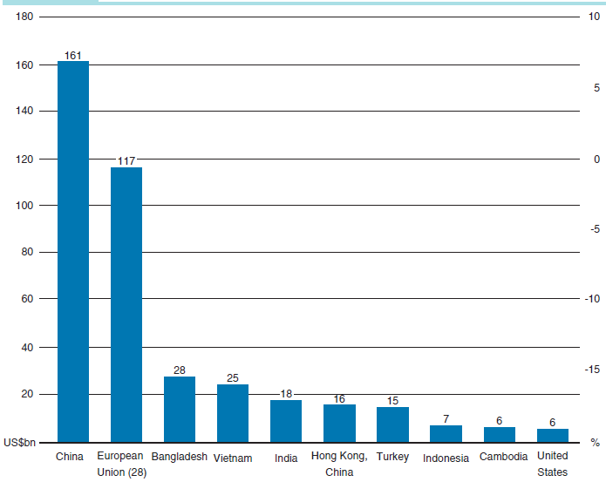
Table 8-2 Top 10 Clothing Exporters 2016 ($ Billions)

Slide 10
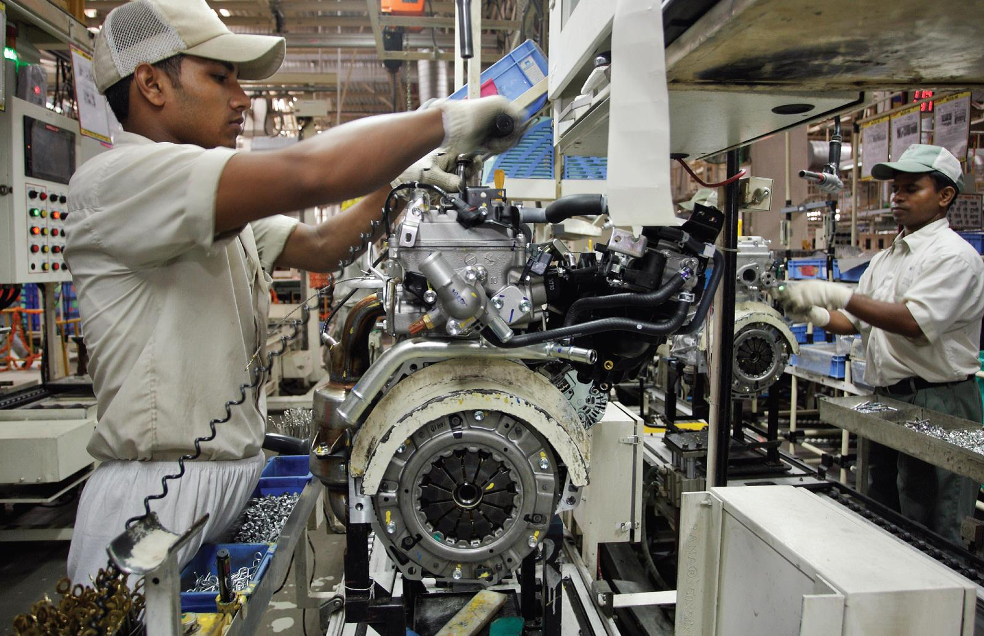
National Policies Governing Exports and Imports
Most nations encourage exports and restrict imports
In 2014, the total was $2.8 trillion
European Union trade, domestic and foreign, is $3 trillion +
A worker at an auto plant in India.
Notes:
In 1997 total imports of goods and services by the United States passed the $1 trillion mark for the first time; in 2017, the combined figure was $2.9 trillion.
China’s pace-setting economic growth in the Asia-Pacific region is reflected by trends in both exports and imports. Exports from China have grown significantly; and they are growing even now that China has joined the WTO. Historically, China protected its own producers by imposing double-digit import tariffs. These are being reduced as China complies with WTO regulations.
For centuries, nations have combined two opposing policy attitudes toward the movement of goods across national boundaries. On the one hand, nations directly encourage exports; the flow of imports, on the other hand, is generally restricted.

Slide 11
Government Programs That Support Exports (1 of 2)
Governments concerned about trade deficits or economic development should educate firms about possible gains from exporting
Done at the national, regional, & local levels
After
Japan’s trade ministry developed export
strategies
The China triangle (People’s Republic, Taiwan, & Hong Kong), & the four tigers--Singapore, South Korea, Taiwan, & Hong Kong) learned from Japan and built strong export-based economies
Notes:
Although Asia’s “economic bubble” burst in 1997 as a result of uncontrolled growth, Japan and the tigers are moving forward in the twenty-first century at a more moderate rate. China, an economy unto itself, has attracted increased foreign investment from Daimler AG, General Motors (GM), Hewlett-Packard, and scores of other companies that are setting up production facilities to support local sales, as well as exports to world markets.

Slide 12
Government Programs That Support Exports (2 of 2)
Tax incentives
Subsidies
Governmental assistance
Free trade zones
Notes:
Governments commonly use four activities to support export activities of national firms. First, tax incentives treat earnings from export activities preferentially either by applying a lower rate to earnings from these activities or by refunding taxes already paid on income associated with exporting. The tax benefits offered by export-conscious governments include varying degrees of tax exemption or tax deferral on export income, accelerated depreciation of export-related assets, and generous tax treatment of overseas market development activities.
Governments also support export performance by providing outright subsidies, which are direct or indirect financial contributions that benefit producers. Subsidies can severely distort trade patterns when less competitive but subsidized producers displace competitive producers in world markets.
The third support area is governmental assistance to exporters. Companies can avail themselves of a great deal of government information concerning the location of markets and credit risks. Assistance may also be oriented toward export promotion.
In an effort to facilitate exports, countries are designating certain areas as free trade zones (FTZ) or special economic zones (SEZ). These are geographic entities that offer manufacturers simplified customs procedures, operational flexibility, and a general environment of relaxed regulations.

Slide 13
Governmental Actions to Discourage Imports and Block Market Access
Tariffs: 3 Rs-rules, rate schedules, & regulations
Import controls
Nontariff barriers (hidden)
Quotas
Discriminatory procurement policies (Buy American Act of 1933 for federal agencies)
Restrictive customs procedures
Arbitrary monetary policies
Restrictive administrative & technical regulations
Notes:
Measures such as tariffs, import controls, and a host of nontariff barriers are designed to limit the inward flow of goods. Tariffs can be thought of as the “three R’s” of global business: rules, rate schedules (duties), and regulations of individual countries.
A nontariff trade barrier (NTB) is any measure other than a tariff that is a deterrent or obstacle to the sale of products in a foreign market. NTBs are also known as hidden trade barriers. A quota is a government-imposed limit or restriction on the number of units or the total value of a particular product or product category that can be imported. Quotas are designed to protect domestic producers. In 2005, for example, textile producers in Italy and other European countries were granted quotas on 10 categories of textile imports from China. The quotas, which ran through the end of 2007, were designed to give European producers an opportunity to prepare for increased competition. Discriminatory procurement policies can take the form of government rules and administrative regulations that give local vendors priority. The Buy American Act of 1993 says federal agencies must buy American products unless a domestic product is not available, the cost is unreasonable, or it would not be in the public’s interest.
Customs procedures are considered restrictive if they are administered in a way that makes compliance difficult and expensive. For example, the U.S. Department of Commerce might classify a product under a certain harmonized number; Canadian customs may disagree. The U.S. exporter may have to attend a hearing with Canadian customs officials to reach an agreement. Such delays cost time and money for both the importer and the exporter.
Discriminatory exchange rate policies distort trade in much the same way as selective import duties and export subsidies. As noted earlier, some Western policymakers have argued that China is pursuing policies that ensure an artificially weak currency which results in Chinese goods having a competitive price edge in world markets. Restrictive administrative and technical regulations can also create barriers to trade. These may take the form of antidumping regulations, product size regulations, and safety and health regulations. U.S. safety and pollution regulations in the auto industry have forced some auto makers to withdraw certain models and are generally expensive with which to comply.

Slide 14
Table 8-3 Examples of Trade Barriers
Country/Region | Tariff Barriers | Nontariff Barriers
European Union | 16.5% antidumping tariff on shoes from China, 10% on shoes from Vietnam | Quotas on Chinese textiles
China | Tariffs as high as 28% on foreign-made auto parts | Expensive, time-consuming procedures for obtaining pharmaceutical import licenses

Slide 15
Harmonized Tariff System
Developed by the World Customs Organization
Effective January 1989
Adopted by most trading nations
Importers & Exporters have to determine the classification number for any product moved across borders
Import & export numbers are the same on Schedule B
Meant to simplify tariff procedures but problems still arise
Notes:
In spite of the progress made in simplifying tariff procedures, administering a tariff is an enormous burden. People who work with imports and exports must familiarize themselves with the different classifications and use them accurately. Even a tariff schedule of several thousand items cannot clearly describe every product traded globally. Plus, the introduction of new products and new materials used in manufacturing processes creates new problems. Often, determining the duty rate on a particular article requires assessing how the item is used or determining its main component material. Two or more alternative classifications may have to be considered. A product’s classification can make a substantial difference in the duty applied. For example, is a Chinese-made X-Men action figure a doll or a toy? For many years, dolls were subject to a 12 percent duty when imported into the United States; the rate was 6.8 percent for toys. Moreover, action figures that represent nonhuman creatures such as monsters or robots were categorized as toys and thus qualified for lower duties than human figures that the Customs Service classified as dolls. Duties on both categories have been eliminated; however, the Toy Biz subsidiary of Marvel Enterprises spent nearly 6 years on an action in the U.S. Court of International Trade to prove that its X-Men action figures do not represent humans. Although the move appalled many fans of the mutant superheroes, Toy Biz hoped to be reimbursed for overpayment of past duties made when the U.S. Customs Service had classified imports of Wolverine and his fellow figures as dolls.

Slide 16
Tariff Systems
Single-column tariff
Simplest type of tariff
Schedule of duties in which rate applies to imports from all countries on the same basis
Two-column tariff
General duties plus special duties apply
Normal Trade Relations (N T R) means that countries in the W T O apply the Column 1 rates most favorable or lowest rates to all nations (with exceptions). Column 2 rates are for non-W T O countries
Notes:
Tariff systems provide either a single rate of duty for each item applicable to all countries or two or more rates, applicable to different countries or groups of countries. Tariffs are usually grouped into two classifications. The single-column tariff is the simplest type of tariff; a schedule of duties in which the rate applies to imports from all countries on the same basis. Under the two-column tariff (Table 8-4), column 1 includes “general” duties plus “special” duties indicating reduced rates determined by tariff negotiations with other countries.

Slide 17
Table 8-4 Sample Rates of Duty for U.S. Imports
Blank | Column 1 | Column 2
General | Special | Non-N T R
1.5% | Free (A, E, I L, J, M X) 0.4% (C A) | 30%
A: Generalized System of Preferences
E: Caribbean Basin Initiative (C B I) Preference
I L: Israel Free Trade Agreement (F T A) Preference
J: Andean Agreement Preference
M X: North American Free Trade Agreement (N A F T A) Canada Preference
C A: N A F T A Mexico Preference
Notes:
Under the two-column tariff, column 1 includes “general” duties plus “special” duties indicating reduced rates determined by tariff negotiations with other countries. Rates agreed upon by “convention” are extended to all countries that qualify for normal trade relations (NTR; formerly most-favored nation or MFN) status within the framework of the WTO. Under the WTO, nations agree to apply their most favorable tariff or lowest tariff rate to all nations—subject to some exceptions— that are signatories to the WTO. Column 2 shows rates for countries that do not enjoy NTR status.

Slide 18
Preferential Tariff
Reduced tariff rate applied to imports from certain countries
G A T T prohibits the use, with three exceptions:
Historical preference arrangements already existed
Preference is part of formal economic integration treaty
Industrial countries are permitted to grant preferential market access to L D Cs
Notes:
A preferential tariff is a reduced tariff rate applied to imports from certain countries. GATT prohibits the use of preferential tariffs, with three major exceptions. First are historical preference arrangements such as the British Commonwealth preferences and similar arrangements that existed before GATT. Second, preference schemes that are part of a formal economic integration treaty, such as free trade areas or common markets, are excluded. Third, industrial countries are permitted to grant preferential market access to companies based in less-developed countries.
The United States is now a signatory to the GATT customs valuation code. U.S. customs value law was amended in 1980 to conform to the GATT valuation standards. Under the code, the primary basis of customs valuation is “transaction value.” As the name implies, transaction value is defined as the actual individual transaction price paid by the buyer to the seller of the goods being valued. In instances where the buyer and seller are related parties (e.g., when Honda’s U.S. manufacturing subsidiaries purchase parts from Japan), customs authorities have the right to scrutinize the transfer price to make sure it is a fair reflection of market value. In the late 1980s, the U.S. Treasury Department began a major investigation into the transfer prices charged by the Japanese automakers to their U.S. subsidiaries. It charged that the Japanese paid virtually no U.S. income taxes because of their “losses” on the millions of cars they import into the United States each year.

Slide 19
Customs Duties
Ad valorem duty
Expressed as percentage of value of goods
Specific duty
Expressed as specific amount of currency per unit of weight, volume, length, or other unit of measurement
Compound or mixed duties
Apply
Notes:
Duties on individual products or services are listed in the schedule of rates in the previous slides. As defined by one expert on global trade, duties are “taxes that punish individuals for making choices of which their governments disapprove.”
Before World War II, specific duties were widely used and the tariffs of many countries, particularly those in Europe and Latin America, were extremely complex. During the past half century, the trend has been toward the conversion to ad valorem duties; that is, duties expressed as a certain percentage of the value of the goods.
Customs duties are divided into two categories. They may be calculated either as a percentage of the value of the goods (ad valorem duty), as a specific amount per unit (specific duty), or as a combination of both of these methods.
As noted, an ad valorem duty is expressed as a percentage of the value of goods. The definition of customs value varies from country to country. An exporter is well advised to secure information about the valuation practices applied to his or her product in the country of destination, so that the exporter can price that product to be competitive with local producers. In countries adhering to GATT conventions on customs valuation, the customs value is the value of cost, insurance, and freight (CIF) at the port of importation. This figure should reflect the arm’s-length price of the goods at the time the duty becomes payable.
A specific duty is expressed as a specific amount of currency per unit of weight, volume, length, or other unit of measurement—for example, “50 cents U.S. per pound,” “$1.00 U.S. per pair,” or “25 cents U.S. per square yard.” Specific duties are usually expressed in the currency of the importing country, but there are exceptions, particularly in countries that have experienced sustained inflation.

Slide 20
Other Duties and Import Charges
Anti-dumping Duties
Dumping is the sale of merchandise in export markets at unfair prices
Special import charges equal to the dumping margin
Countervailing Duties offset subsidies of the exporting country
Variable Import Levies apply to agriculture
Temporary Surcharges protect local industries and are used to adjust balance of payment deficits
Notes:
Antidumping duties are almost invariably applied to products that are also manufactured or grown in the importing country. In the United States, antidumping duties are assessed after the commerce department finds a foreign company guilty of dumping and the International Trade Commission rules that the dumped products injured American companies. Countervailing duties (CVDs) are additional duties levied to offset subsidies granted in the exporting country.
Variable import levies apply to certain categories of imported agricultural products. If prices of imported products would undercut those of domestic products, the effect of these levies would be to raise the price of imported products to the domestic price level. In 2001, the ITC and commerce department imposed both countervailing and antidumping duties on Canadian lumber producers. The CVDs were intended to offset subsidies to Canadian sawmills in the form of low fees for cutting trees in forests owned by the Canadian government. The antidumping duties on imports of softwood lumber, flooring, and siding were in response to complaints by American producers that the Canadians were exporting lumber at prices below their production cost.
Temporary surcharges have been introduced from time to time by certain countries, such as the United Kingdom and the United States, to provide additional protection for local industry and, in particular, in response to balance-of-payments deficits.

Slide 21
Key Export Participants
Foreign purchasing agents
Export brokers
Export merchants
Export management companies
Manufacturers export agent
Export commission representative
Cooperative exporter
Freight forwarders
Notes:
Anyone with responsibilities for exporting should be familiar with some of the people and organizations who can assist with various tasks. Some of these, including purchasing agents, export brokers, and export merchants, have no assignment of responsibility from the client. Others, including export management companies, manufacturers’ export representatives, export distributors, and freight forwarders, are assigned responsibilities by the exporter.
Foreign purchasing agents are variously referred to as buyer for export, export commission house, or export confirming house. They operate on behalf of, and are compensated by, an overseas customer known as a principal. They generally seek out a manufacturer whose price and quality match the specifications of their principal. Foreign purchasing agents often represent governments, utilities, railroads, and other large users of materials. Foreign purchasing agents do not offer the manufacturer or exporter stable volume except when long-term supply contracts are agreed upon.
An export broker receives a fee for bringing together the seller and the overseas buyer. The fee is usually paid by the seller, but sometimes the buyer pays it.
Export merchants are sometimes referred to as jobbers. These are marketing intermediaries that identify market opportunities in one country or region and make purchases in other countries to fill these needs. An export merchant typically buys unbranded products directly from the producer or manufacturer. The export merchant then brands the goods and performs all other marketing activities for them, including distribution.
An export management company (EMC) is an independent marketing intermediary that acts as the export department for two or more manufacturers (principals) whose product lines do not compete with each other. The EMC usually operates in the name of its principals for export markets, but it may operate in its own name. It may act as an independent distributor, purchasing and reselling goods at an established price or profit margin. Alternatively, it may act as a commissioned representative, taking no title and bearing no financial risks in the sale. It performs all other marketing activities, including distribution.
A manufacturer’s export agent (MEA) Much like an EMC, the MEA can act as an export distributor or as an export commission representative. However, the MEA does not perform the functions of an export department, and the scope of market activities is usually limited to a few countries.
An export commission representative assumes no financial risk. The manufacturer assigns some or all foreign markets to the commission representative. The manufacturer carries all accounts, although the representative often provides credit checks and arranges financing.
A cooperative exporter, sometimes called a mother hen, a piggyback exporter, or an export vendor, is an export organization of a manufacturing company retained by other independent manufacturers to sell their products in foreign markets. Cooperative exporters usually operate as export distributors for other manufacturers, but in special cases they operate as export commission representatives. They are regarded as a form of export management company.
Freight forwarders are licensed specialists in traffic operations, customs clearance, and shipping tariffs and schedules; simply put, they can be thought of as travel agents for freight.

Slide 22
Organizing for Exporting in the Manufacturer’s Country
Exports can be handled
As a part-time activity performed by domestic employees
Through an export partner
Through an export department
Through an export department within an international division
For multi-divisional companies; each possibility exists for each division
Notes:
Home-country issues involve deciding whether to assign export responsibility inside the company or to work with an external organization specializing in a product or geographic area. Most companies handle export operations within their own in-house export organization. Depending on the company’s size, responsibilities may be incorporated into an employee’s domestic job description. Alternatively, these responsibilities may be handled as part of a separate division or organizational structure.

Slide 23
Organizing for Exporting in the Market Country
Direct market representation
Advantages: control and communications
Representation by independent intermediaries
Advantages: best for situations with small sales volume
Notes:
In addition to deciding whether to rely on in-house or external export specialists in the home country, a company must also make arrangements to distribute the product in the target market country. Direct market representation does not mean selling directly to the end user but selling to wholesalers or retailers. Every exporting organization faces one basic decision: To what extent do we rely on direct market representation as opposed to representation by independent intermediaries?

Slide 24
Trade Financing and Methods of Payment
Cash with order
Open account
Documentary credits (letter of credit)
Documentary collections (bill of exchange)
Notes:
For a company to be paid for its export sales should be obvious. Yet, many who are new to international trade consider this issue only as an afterthought. Experienced exporters and importers (sellers and buyers) consider the financial and shipping terms of a transaction to be a normal part of any negotiation. In fact, settling the details of a transaction is a valuable act of discipline for all parties to limit future misunderstandings or conflicts. The credit and collection functions are both art and science and require ongoing senior management oversight. There is no “one size fits all” approach to trade finance. Naturally, from a marketing perspective, a firm needs to ensure its terms of sale are competitive.
Selling across borders is inherently riskier than selling within one’s home country. Managers may have only limited understanding of topics covered in previous chapters of this book, including language, cultural differences, and foreign political environments. Another reality is that, outside of the OECD economies, a firm will have no effective legal recourse if difficulties arise. Those engaging in international trade must manage the central risks of “nonpayment” and “nonperformance” by their business partners—situations where the exporter might not receive payment for its goods or where the importer might not receive what had been promised. Fortunately, the international banking system plays a critical role in enabling successful international commerce by reducing these transaction risks.

Slide 25
Documentary Credit-Letter of Credit (1 of 2)
Banking system helps manage risk through a Letter of Credit (L/C)
Importer’s bank is the issuing bank. It opens an L/C in favor of the exporter (beneficiary)
May require deposit of funds by the importer
L/C is sent to the Exporter’s bank (negotiating or advising bank)
Most common type is an irrevocable letter of credit. Opening bank must pay without changes approved from buyer and seller.
Notes:
This is where the banking system helps manage the risk via a key document called the letter of credit (L/C) (also known as a documentary credit). An L/C substitutes a bank’s creditworthiness for that of the importer. From the exporter’s perspective, if it ships and “performs” under an L/C, it can rely on the full faith and credit of that bank for payment—not the creditworthiness of the buyer. At the same time, the importer is not obligated to pay for the shipment unless and until the exporter has performed under the terms specified in the L/C. Performance is demonstrated when the exporter provides the buyer’s bank with a documentary package. This agreed-upon set of documents, which are listed in the L/C, collectively demonstrates that the exporter has performed as agreed.
The importer’s bank is known as the “issuing” or “opening” bank. At the request of the buyer, it “opens” an L/C “in favor of” the exporter, which is thereafter referred to as the “beneficiary.” In some instances, the opening bank may require the importer to deposit funds or provide collateral against the L/C because the bank is, in essence, extending its own credit on behalf of the importer. However, if there is an established relationship between the bank and the importer, this requirement may be waived. The now-opened L/C is sent to the exporter’s bank, which then advises the exporter that an L/C has been opened in its favor. The exporter’s bank is referred to as the “negotiating” or “advising” bank.
The most common type of L/C is an irrevocable letter of credit. As the name implies, the bank issuing the L/C cannot cancel (“revoke”) or modify the L/C terms without obtaining approval from both the exporter and the importer. The key point, from the exporter’s perspective, is that even if the importer subsequently cancels the order or fails to pay for the merchandise, the opening bank remains obligated to pay the exporter so long as the exporter has fulfilled the terms given in the L/C.
If the exporter desires (at its prerogative), it can secure an extra layer of protection (for a fee) by asking its advising bank to confirm the L/C of the opening bank. Such a confirmation adds the full faith and credit of the exporter’s bank on top of the existing pledge by the importer’s bank. If the buyer’s opening bank ultimately does not or cannot pay—due, for example, to government-imposed currency controls—the exporter is still guaranteed payment by its own bank. In this scenario, the exporter is said to be operating under a confirmed irrevocable letter of credit. Bank fees for opening an L/C vary by country and commercial risk, but can range from ⅛% to 1% of the total credit. Banks charge similar fees for confirming an L\C.
After being satisfied that it can perform under the L/C terms, the exporter will produce and ship the product to the importer. The exporter then assembles the group of documents listed in the L/C. As noted earlier, the L/C includes an agreed-upon (by buyer and seller) list of documents that will be considered evidence of the seller’s performance. This documentary package often includes commercial invoices, drafts, packing lists, certificates of insurance, certificates of origin, and ocean bills of lading (which represent title to the shipment). The documentary package and the L/C are sent via the advising (or now confirming) bank and “presented” to the buyer’s opening bank. The buyer’s bank reviews the documentary package and, if all is in order, will “honor” the credit.
If the transaction is conducted under a sight draft, the bank will promptly transfer payment to the beneficiary. If the exporter had agreed to extended credit terms, the draft in the documentary package would be a time draft and the bank would remit payment after that agreed-upon period. At this point, for the importer to take possession of the shipment, the opening bank will arrange for the buyer to make its payment, either at sight or at the later time given in the time draft. Upon the importer paying the opening bank or signing a promissory note (pledging to make the future payment), the bank will release the documentary package to the buyer. This package includes the ocean bills of lading (and thus title to the goods), enabling the importer to take possession of those goods from the freight carrier. In this process, it is important to note that banks operate only against documents—not on handshakes, contracts, or the shipment’s physical move.

Slide 26
Documentary Credit-Letter of Credit (2 of 2)
Exporter produces and ships product to the importer
Exporter assembles documents listed in the L/C that show evidence of seller’s performance
If using a sight draft, bank transfers payment to the beneficiary
If using a time draft, bank would pay at the agreed-upon time
Opening bank arranges for the buyer to pay
When importer pays opening bank, it releases the documentary package to the buyer so it can get the goods
Notes:
Over time, an exporter and an importer may establish a good working relationship and decide to move to a simpler, less-complicated form of payment called documentary collection. Engaging in such an arrangement requires the exporter to balance the high risk of shipping under open account against the burdensome but low risk of operating under an L/C. Banks are again involved as intermediaries, but provide no guarantees or credit. With a documentary collection, using either a sight draft or time draft, the exporter produces and ships the ordered product. The documentary package, including a draft, is sent to the exporter’s correspondent bank (working on behalf of the exporter) in the buyer’s country. The importer goes to the bank and makes payment per the terms specified in the draft. In the case of a sight draft (a process known as documents against payment), title to the goods passes to the importer when it makes payment to the bank and the bank releases the shipping documents (including bills of lading representing title to the goods). Again, this is separate from the physical movement of the goods.
For the exporter, a higher-risk variation involves a time draft (a process known as documents against acceptance). In this case, the exporter would again send a draft and documentary package to its correspondent bank. There, the buyer signs and thus “accepts” the time draft (now a formal obligation for payment at a future date) in exchange for the document package from the correspondent bank. When the accepted time has elapsed, the correspondent bank collects and relays the payment from the importer.
Neither of these options protects the exporter from a buyer that cancels a shipment or refuses to pay. Also, documents against acceptance has the added risk of a buyer taking physical possession without payment.

Slide 27
Methods of Payment
Documentary Collections (Sight or Time Drafts) are a simpler, less-complicated form of payment
Balances risk of shipping under open account against burdensome L/C
Sight draft through the process documents against credit title to the goods passes to the importer when it makes payment to the bank which releases the shipping documents, including the bill of lading (title)
Higher risk is a time draft through the process documents against acceptance. Exporter sends documents to the bank but gets paid later.
Notes:
Over time, an exporter and an importer may establish a good working relationship and decide to move to a simpler, less-complicated form of payment called documentary collection. Engaging in such an arrangement requires the exporter to balance the high risk of shipping under open account against the burdensome but low risk of operating under an L/C. Banks are again involved as intermediaries, but provide no guarantees or credit. With a documentary collection, using either a sight draft or time draft, the exporter produces and ships the ordered product. The documentary package, including a draft, is sent to the exporter’s correspondent bank (working on behalf of the exporter) in the buyer’s country. The importer goes to the bank and makes payment per the terms specified in the draft. In the case of a sight draft (a process known as documents against payment), title to the goods passes to the importer when it makes payment to the bank and the bank releases the shipping documents (including bills of lading representing title to the goods). Again, this is separate from the physical movement of the goods.

Slide 28
Customs Trade Partnership Against Terrorism
The U.S. Customs and Border Patrol inspects cargo
C-T P A T aims to have businesses certify their security and that of their partners
They get inspection priority
Notes:
As noted on the Customs and Border Protection Web site, “C-TPAT recognizes that U.S. Customs and Border Protection (CBP) can provide the highest level of cargo security only through close cooperation with the ultimate owners of the international supply chain such as importers, carriers, consolidators, licensed customs brokers, and manufacturers. Through this initiative, CBP is asking businesses to ensure the integrity of their security practices and communicate and verify the security guidelines of their business partners within the supply chain.”

Slide 29
Duty Drawback
Refunds of duties paid on imports that are processed or incorporated into other goods And re-exported
Reduce the price of imported production inputs
Used in the U.S. to encourage exports
After N A F T A, U.S. reduced drawbacks on exports to Canada and Mexico
China had to reduce drawbacks in order to join the W T O
Notes:
Another issue with imports and exports is duty drawback—that is, refunds of duties paid on imports that are processed or incorporated into other goods and then reexported. Drawbacks have long been used in the United States to encourage exports. However, when NAFTA was negotiated, the U.S. trade representative agreed to restrict drawbacks on exports to Canada and Mexico. As the United States negotiates new trade agreements, some industry groups are lobbying in favor of
keeping drawbacks. Duty drawbacks are also common in protected economies and represent a policy instrument that aids exporters by reducing the price of imported production inputs. China was required to remove duty drawbacks as a condition for joining the WTO. As duty rates around the world fall, the drawback issue will become less important.

Slide 30
Sourcing
The Sourcing Decision
Does the company buy or make its products?
Where?
Global outsourcing or offshoring refers to moving work to another country
Call Centers were first nonmanufacturing moved
Includes white-collar, high-tech service-sector jobs
Tax returns, insurance claims, medical scans and x-rays, architectural drawings
Notes:
In global marketing, the issue of customer value is inextricably tied to the sourcing decision: whether a company makes or buys its products as well as where it makes or buys its products. Outsourcing means shifting production jobs or work assignments to another company to cut costs. When the outsourced work moves to another country, the terms global outsourcing and offshoring are sometimes used. In today’s competitive marketplace, companies are under intense pressure to lower costs; one way to do this is to locate manufacturing and other activities in China, India, and other low-wage countries. And why not? Many consumers do not know where the products they buy—athletic shoes, for example—are manufactured.
As this discussion suggests, the decision of where to locate key business activities depends on factors besides cost. There are no simple rules to guide sourcing decisions. Thus the sourcing decision is one of the most complex and important decisions faced by a global company. Several factors may figure into the sourcing decision: management vision, factor costs and conditions, customer needs, public opinion, logistics, country infrastructure, the political environment, and exchange rates.

Slide 31
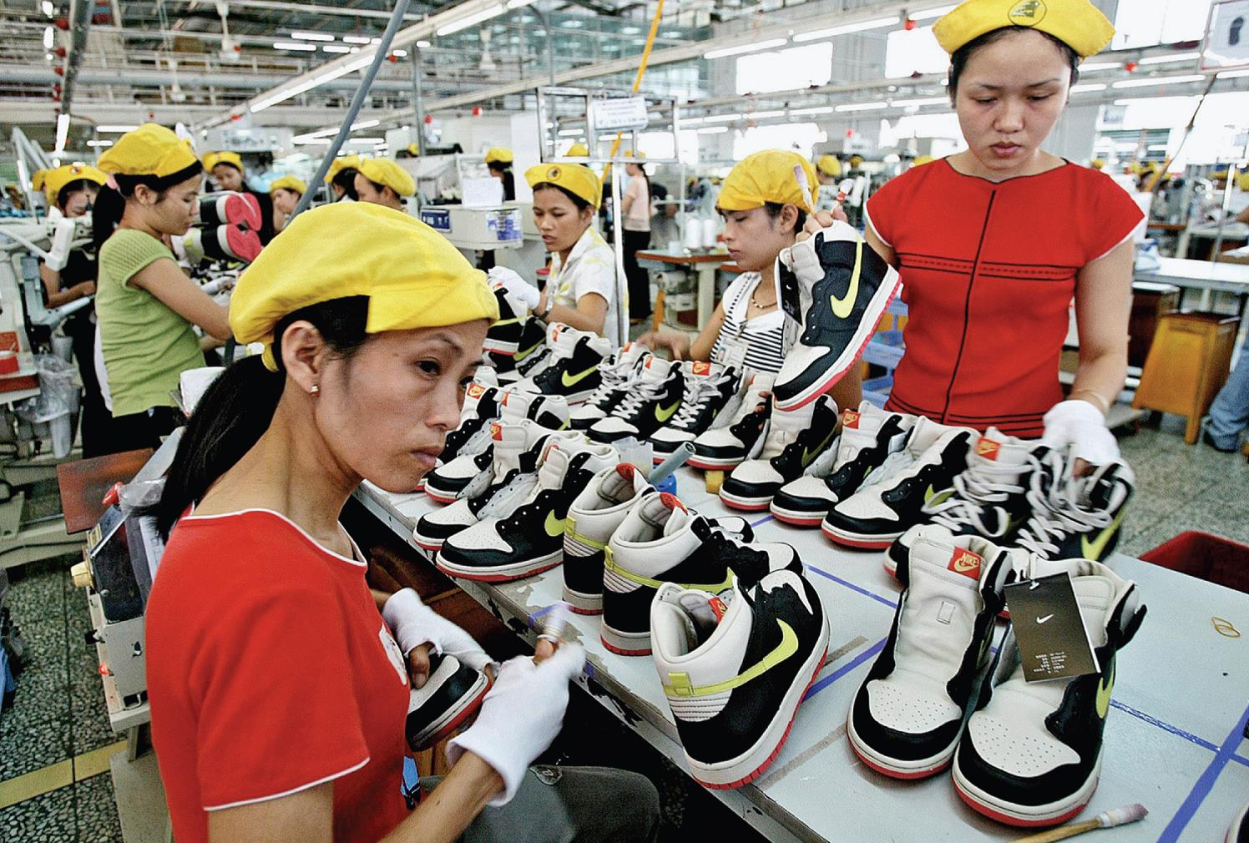
Factors That Affect Sourcing
Management vision
Factor costs and conditions
Customer needs
Public opinion
Logistics
Country infrastructure
Political environment
Exchange rates

Slide 32
Other Export/Import Issues (1 of 3)
Management Vision
Some C E O s want to keep manufacturing at home (Swatch)
Some C E O s focus on high-value-added products rather than manufacturing sites (Canon keeps 60% in Japan)
Factor Costs & Conditions
The cost of land, labor & capital costs
Labor in emerging markets less than $1 per hour., but $6-$12 in developed countries
Sometimes the cost of land, materials, & capital offset each other
Notes:
Management Vision Some chief executives are determined to retain some or all manufacturing in their home country. The late Nicolas Hayek was one such executive. When he was head of the Swatch Group, Hayek presided over the spectacular revitalization of the Swiss watch industry. The Swatch Group’s portfolio of brands includes Blancpain, Omega, Breguet, Rado, and, of course, the inexpensive Swatch brand itself. Hayek demonstrated that the fantasy and imagination of childhood and youth could be translated into breakthroughs that allow mass-market products to be manufactured in high-wage countries side by side with handcrafted luxury products.
Costs and Conditions Factor costs are land, labor, and capital costs (remember Economics 101!). Labor includes the cost of workers at every level: manufacturing and production, professional and technical, and management. Direct labor costs in basic manufacturing today range from less than $1 per hour in the typical emerging country to $6 to $12 per hour in the typical developed country. In certain industries in the United States, direct labor costs in manufacturing exceed $20 per hour without benefits. German hourly compensation costs for production workers in manufacturing are 160 percent of those in the United States, whereas those in Mexico are a fraction of those in the United States.
Volkswagen’s business environment includes a significant wage differential between Mexico and Germany, the strength of the euro, and growing worldwide demand for compact and subcompact vehicles. Taken together, these factors dictate a Mexican manufacturing facility that builds models destined for the United States, China, Europe, and other key markets. Assembly-line wages for Mexican workers start at about $40 per day; by contrast, German auto workers average $60 per hour in pay and benefits. Volkswagen has invested $1 billion to design and produce the next-generation Jetta at a sprawling plant in Mexico City.
The other factors of production are land, materials, and capital. The costs of these factors depend on their availability and relative abundance. Often, the differences in factor costs will offset each other so that, on balance, companies have a level field in the competitive arena. For example, some countries have abundant land, and Japan has abundant capital. These advantages partially offset each other. When this is the case, the critical factor is management, professional, and worker team effectiveness.
The application of advanced computer controls and other new manufacturing technologies has reduced the proportion of labor relative to capital for many businesses. In formulating a sourcing strategy, company managers and executives should also recognize the declining importance of direct manufacturing labor as a percentage of total product cost. It is certainly true that, for many companies in high-wage countries, the availability of cheap labor is a prime consideration when choosing manufacturing locations; this is why China has become “the world’s workplace.” However, it is also true that direct labor cost may be a relatively small percentage of the total production cost. As a result, it may not be worthwhile to incur the costs and risks of establishing a manufacturing activity in a distant location.

Slide 33
Other Export/Import Issues (2 of 3)
Customer Needs
Needs can trump low cost; Dell moved call centers back to U.S. when customers complained about problems with Indian tech support
Logistics
Improved transportation systems & intermodal services cut time & lower costs
Country Infrastructure
Power, transportation, roads, communications, service & component suppliers, a labor pool, civil order, effective government
Notes:
Logistics In general, the greater the distance between the product source and the target market, the greater the time delay for delivery and the higher the transportation cost. However, innovation and new transportation technologies are cutting both time and dollar costs. To facilitate global delivery, transportation companies such as CSX Corporation are forming alliances and becoming an important part of industry value systems. Manufacturers can take advantage of intermodal services that allow containers to be transferred among rail, boat, air, and truck carriers. In Europe, Latin America, and elsewhere, the trend toward regional economic integration means fewer border controls, which greatly speeds up delivery times and lowers costs.
Country Infrastructure
In order to present an attractive setting for a manufacturing operation, it is important that a country’s infrastructure be sufficiently developed to support manufacturing and distribution. Infrastructure requirements will vary by company and by industry, but minimally, they will include power, transportation and roads, communications, service and component suppliers, a labor pool, civil order, and effective governance. In addition, companies must have reliable access to foreign exchange for the purchase of necessary material and components from abroad. Additional requirements include a physically secure setting where work can be done and from which products can be shipped.
A country may have cheap labor, but does it have the necessary supporting services or infrastructure to support a high volume of business activities? Many countries offer these conditions, including Hong Kong, Taiwan, and Singapore. In scores of other low-wage countries, however, the infrastructure is woefully underdeveloped. In China, a key infrastructure weakness is the “cold chain,” a food industry term for temperature-controlled trucks and warehouses. According to one estimate, an investment of $100 billion will be required to modernize China’s cold chain.

Slide 34
Other Export/Import Issues (3 of 3)
Political Factors
Political risk is higher in less developed countries in Africa, South America, or Asia than in the Triad
Protectionism at the state and federal level
Senate passed an amendment that would prohibit certain agencies from hiring companies that used offshore call centers
Foreign Exchange Rates
Companies try to use global sourcing to limit risk of volatile exchange rates or price levels of commodities
Notes:
Political risk is a deterrent to investment in local sourcing. Conversely, the lower the level of political risk, the less likely it is that an investor will avoid a country or market. The difficulty of assessing political risk is inversely proportional to a country’s stage of economic development: All other things being equal, the less developed a country, the more difficult it is to predict political risk. The political risk of the Triad countries, for example, is quite limited as compared to that of a less-developed country in Africa, Latin America, or Asia. The recent rapid changes in Central and Eastern Europe and the dissolution of the Soviet Union have clearly demonstrated the risks and opportunities resulting from political upheavals.
Other political factors may weigh on the sourcing decision. For example, with protectionist sentiment on the rise, the U.S. Senate passed an amendment that would prohibit the U.S. Treasury and Department of Transportation from accepting bids from private companies that use offshore workers. In a highly publicized move, the state of New Jersey changed a call center contract that had shifted jobs offshore. About one dozen jobs were brought back to the state—at a cost of about $900,000.
Market access is another type of political factor. If a country or a region limits market access because of local content laws, balance of payments problems, or any other reason, it may be necessary to establish a production facility within the country itself. For instance, the Japanese automobile companies invested in U.S. plant capacity because of concerns about market access. By producing cars in the United States, they have a source of supply that is not exposed to the threat of tariff or import quotas. Market access also figured heavily in Boeing’s decision to produce airplane components in China. China ordered 100 airplanes valued at $4.5 billion; in return, Boeing is making investments and transferring engineering and manufacturing expertise.

Slide 35

Copyright
This work is protected by United States copyright laws and is provided solely for the use of instructors in teaching their courses and assessing student learning. Dissemination or sale of any part of this work (including on the World Wide Web) will destroy the integrity of the work and is not permitted. The work and materials from it should never be made available to students except by instructors using the accompanying text in their classes. All recipients of this work are expected to abide by these restrictions and to honor the intended pedagogical purposes and the needs of other instructors who rely on these materials.

